Slide 1
Lecture 9 – Software Security
COM744: Security and Risk Management
Nigel Houlden / Denise Oram
n.houlden@glyndwr.ac.uk / d.oram@Glyndwr.ac.uk

Slide 2
Test
Tuesday 14th January 2020
Room TBA – Please check Moodle

Slide 3
Software Security Issues
Many vulnerabilities result from poor programming practices
Consequence from insufficient checking and validation of data and error codes
Awareness of these issues is a critical initial step in writing more secure program code
Error Categories
Insecure interaction between components
Risky resource management
Porous defences

Slide 4
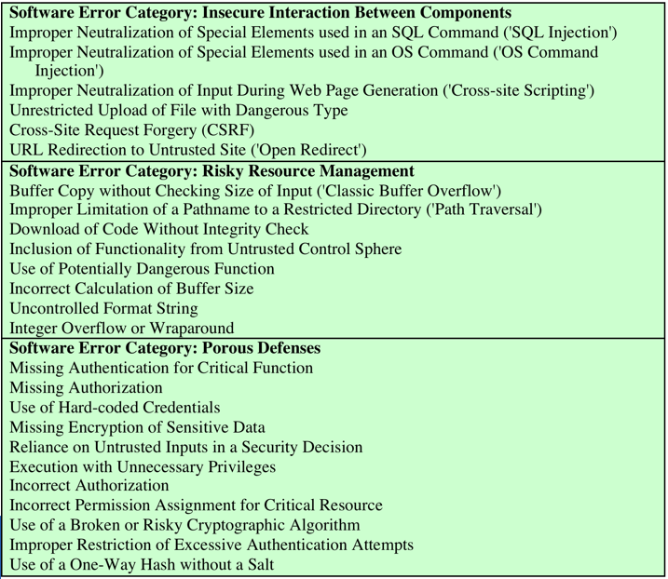
Top most dangerous software errors

Slide 5
Software Security, Quality and Reliability
Software quality and reliability:
Concerned with the accidental failure of program as a result of some theoretically random, unanticipated input, system interaction, or use of incorrect code
Improve using structured design and testing to identify and eliminate as many bugs as possible from a program
Concern is not how many bugs, but how often they are triggered
Software security:
Attacker chooses probability distribution, specifically targeting bugs that result in a failure that can be exploited by the attacker
Triggered by inputs that differ dramatically from what is usually expected
Unlikely to be identified by common testing approaches

Slide 6
Defensive Programming
Designing and implementing software so that it continues to function even when under attack
Requires attention to all aspects of program execution, environment, and type of data it processes
Software is able to detect erroneous conditions resulting from some attack
Also referred to as secure programming
Key rule is to never assume anything, check all assumptions and handle any possible error states

Slide 7
Handling Program Input
Incorrect handling is a very common failing
Input is any source of data from outside and whose value is not explicitly known by the programmer when the code was written
Must identify all data sources
Explicitly validate assumptions on size and type of values before use

Slide 8
How Buffer Overflows Happen
// A C program to demonstrate buffer overflow
#include <stdio.h>
#include <string.h>
#include <stdlib.h>
int main(int argc, char *argv[])
{
// Reserve 5 byte of buffer plus the terminating NULL.
// should allocate 8 bytes = 2 double words,
// To overflow, need more than 8 bytes...
char buffer[5]; // If more than 8 characters input
// by user, there will be access violation, segmentation fault
// a prompt how to execute the program...
if (argc < 2)
{
printf("strcpy() NOT executed....\n");
printf("Syntax: %s <characters>\n", argv[0]);
exit(0);
}
// copy the user input to mybuffer, without any
// bound checking a secure version is srtcpy_s()
strcpy(buffer, argv[1]);
printf("buffer content= %s\n", buffer);
// you may want to try strcpy_s()
printf("strcpy() executed...\n");
return 0;
}

Slide 9
Harm from Buffer Overflows
Overwrite:
Another piece of your program’s data
An instruction in your program
Data or code belonging to another program
Data or code belonging to the operating system
Overwriting a program’s instructions gives attackers that program’s execution privileges
Overwriting operating system instructions gives attackers the operating system’s execution privileges

Slide 10
Buffer Overflow Attacks
To exploit a buffer overflow an attacker needs:
To identify a buffer overflow vulnerability in some program that can be triggered using externally sourced data under the attacker’s control
To understand how that buffer is stored in memory and determine potential for corruption
Identifying vulnerable programs can be done by:
Inspection of program source
Tracing the execution of programs as they process oversized input
Using tools such as fuzzing to automatically identify potentially vulnerable programs

Slide 11
Stack Buffer Overflows
Occur when buffer is located on stack
Also referred to as stack smashing
Used by Morris Worm
Exploits included an unchecked buffer overflow
Are still being widely exploited
Stack frame
When one function calls another it needs somewhere to save the return address
Also needs locations to save the parameters to be passed in to the called function and to possibly save register values

Slide 12
Unsafe C Standard Library Routines

Slide 13
Shellcode
Code supplied by attacker
Often saved in buffer being overflowed
Traditionally transferred control to a user command-line interpreter (shell)
Machine code
Specific to processor and operating system
Traditionally needed good assembly language skills to create
More recently a number of sites and tools have been developed that automate this process
Metasploit Project
Provides useful information to people who perform penetration, IDS signature development, and exploit research

Slide 14
Stack Overflow Variants
Target program can be:
A trusted system utility
Network service daemon
Commonly used library code
Shellcode functions
Launch a remote shell when connected to
Create a reverse shell that connects back to the hacker
Use local exploits that establish a shell
Flush firewall rules that currently block other attacks
Break out of a chroot (restricted execution) environment, giving full access to the system

Slide 15
Buffer Overflow Defences
Buffer overflows are widely exploited
Two broad defense approaches
Compile-time
Aim to harden programs to resist attacks in new programs
Run-time
Aim to detect and abort attacks in existing programs

Slide 16
Programming Languages
Use a modern high-level language
Not vulnerable to buffer overflow attacks
Compiler enforces range checks and permissible operations on variables
Disadvantages
Additional code must be executed at run time to impose checks
Flexibility and safety comes at a cost in resource use
Distance from the underlying machine language and architecture means that access to some instructions and hardware resources is lost
Limits their usefulness in writing code, such as device drivers, that must interact with such resources

Slide 17
Safe Coding Techniques
C designers placed much more emphasis on space efficiency and performance considerations than on type safety
Assumed programmers would exercise due care in writing code
Programmers need to inspect the code and rewrite any unsafe coding
An example of this is the OpenBSD project
Programmers have audited the existing code base, including the operating system, standard libraries, and common utilities
This has resulted in what is widely regarded as one of the safest operating systems in widespread use

Slide 18
Language Extensions/Safe Libraries
Handling dynamically allocated memory is more problematic because the size information is not available at compile time
Requires an extension and the use of library routines
Programs and libraries need to be recompiled
Likely to have problems with third-party applications

Slide 19
Stack Protection
Add function entry and exit code to check stack for signs of corruption
Use random canary
Value needs to be unpredictable
Should be different on different systems
Stackshield and Return Address Defender (RAD)
Function entry writes a copy of the return address to a safe region of memory
Function exit code checks the return address in the stack frame against the saved copy
If change is found, aborts the program

Slide 20
Executable Address Space Protection
Use virtual memory support to make some regions of memory non-executable
Requires support from memory management unit (MMU)
Issues
Support for executable stack code
Special provisions are needed

Slide 21
Address Space Randomisation
Manipulate location of key data structures
Stack, heap, global data
Using random shift for each process
Large address range on modern systems means wasting some has negligible impact
Randomise location of heap buffers
Random location of standard library functions

Slide 22
Heap Overflow
Attack buffer located in heap
Typically located above program code
Memory is requested by programs to use in dynamic data structures (such as linked lists of records)
No return address
Hence no easy transfer of control
May have function pointers can exploit
Or manipulate management data structures
Defences
Making the heap non-executable
Randomising the allocation of memory on the heap

Slide 23
Race Conditions
Without synchronisation of accesses it is possible that values may be corrupted or changes lost due to overlapping access
Arise when writing concurrent code

Slide 24
Race Conditions
Suppose for a moment that two processes need to perform a bit flip at a specific memory location.
Under normal circumstances the operation should work like this:
Process 1 | Process 2 | Memory Value
Read value |  | 0
Flip Value |  | 1
 | Read value | 1
 | Flip Value | 0
In this example, Process 1 performs a bit flip, changing the memory value from 0 to 1. Process 2 then performs a bit flip and changes the memory value from 1 to 0

Slide 25
Race Conditions
If a race condition occurred causing these two processes to overlap, the sequence could potentially look more like this:
Process 1 | Process 2 | Memory Value
Read value |  | 0
 | Read value | 0
Flip Value |  | 1
 | Flip Value | 1
In this example, the bit has an ending value of 1 when its value should be 0. This occurs because Process 2 is unaware that Process 1 is performing a simultaneous bit flip.

Slide 26
Preventing Race Conditions
Need suitable synchronization mechanisms
Most common technique is to acquire a lock on the shared file
Lockfile
Process must create and own the lockfile in order to gain access to the shared resource
If a program chooses to ignore the existence of the lockfile and access the shared resource the system will not prevent this
All programs using this form of synchronization must cooperate

Slide 27
Deadlock
Processes or threads wait on a resource held by the other
One or more programs has to be terminated

Slide 28
Other Programming Oversights
Undocumented access points (backdoors)
Off-by-one errors
Integer overflows
Unterminated null-terminated string
Parameter length, type, or number errors
Unsafe utility libraries

Slide 29
Injection Attacks
Flaws relating to invalid handling of input data, specifically when program input data can accidentally or deliberately influence the flow of execution of the program
Most often occur in scripting languages

Slide 30
SQL Injection Example
txtUserid = getRequestString(UserID)
txtSQL = “Select * from users where UserID = “ + txtUserid
For Userid if we enter : 105 or 1=1
Select * from users where UserID = 105 or 1=1
The SQL above is valid and will return ALL rows from the "Users" table, since OR 1=1 is always TRUE.

Slide 31
Countermeasures for Developers
Modular code: Each code module should be
Single-purpose
Small
Simple
Independent
Encapsulation
Information hiding

Slide 32
Code Testing
Unit testing
Integration testing
Function testing
Performance testing
Acceptance testing
Penetration testing

Slide 33
Validating Numeric Input
Additional concern when input data represents numeric values
Internally stored in fixed sized value
8, 16, 32, 64-bit integers
Floating point numbers depend on the processor used
Values may be signed or unsigned
Must correctly interpret text form and process consistently
Have issues comparing signed to unsigned
Could be used to thwart buffer overflow check

Slide 34
Input Fuzzing
Software testing technique that uses randomly generated data as inputs to a program
Range of inputs is very large
Intent is to determine if the program or function correctly handles abnormal inputs
Assists with reliability as well as security

Slide 35
Operating System Interaction
Systems have a concept of multiple users
Resources are owned by a user and have permissions granting access with various rights to different categories of users
Programs need access to various resources, however excessive levels of access are dangerous
Concerns when multiple programs access shared resources such as a common file

Slide 36
Environment Variables
Collection of string values inherited by each process from its parent
Can affect the way a running process behaves
Included in memory when it is constructed
Can be modified by the program process at any time
Modifications will be passed to its children
Another source of untrusted program input
Most common use is by a local user attempting to gain increased privileges
Goal is to subvert a program that grants superuser or administrator privileges

Slide 37
Use of Least Privilege
Privilege escalation
Exploit of flaws may give attacker greater privileges
Least privilege
Run programs with least privilege needed to complete their function
Determine appropriate user and group privileges required
Decide whether to grant extra user or just group privileges
Ensure that privileged program can modify only those files and directories necessary

Slide 38
Root/Administrator Privileges
Programs with root/ administrator privileges are a major target of attackers
They provide highest levels of system access and control
Are needed to manage access to protected system resources
Often privilege is only needed at start
Can then run as normal user
Good design partitions complex programs in smaller modules with needed privileges
Provides a greater degree of isolation between the components
Reduces the consequences of a security breach in one component
Easier to test and verify

Slide 39
Handling Program Output
Final component is program output
May be stored for future use, sent over net, displayed
May be binary or text
Important from a program security perspective that the output conform to the expected form and interpretation
Programs must identify what is permissible output content and filter any possibly untrusted data to ensure that only valid output is displayed
Character set should be specified

Slide 40
Questions?

